Slide 1






SMART INDIA HACKATHON 2026
TITLE PAGE
Problem Statement ID – SIH26140
Problem Statement Title-AI-Based Interactive Quantum Algorithm Learning Platform
Theme-Smart Education
PS Category- Software
Team ID-
Team Name (Registered on portal)

Slide 2

QuantumTutor AI — Real-Time Adaptive Quantum Algorithm Learning Platform
Your Team Name
Problem:
Our Idea:
Quantum computing education is abstract, English-only, and lacks interactive simulation plus AI-driven diagnosis of student misconceptions, especially for resource-constrained Indian classrooms.
An AI-tutored, CPU-friendly quantum learning platform that combines visual circuit simulation, step-by-step algorithm walkthroughs, adaptive re-teaching with new analogies, and teacher dashboards to expose real misconception patterns in multiple Indian languages.
Proposed Solution:
Interactive Quantum Lab: Visual drag-and-drop circuit builder + Qiskit AerSimulator with real-time state/probability visualization and guided Deutsch–Jozsa & Grover execution.
Adaptive AI Tutor: RAG-grounded AI detects the learner’s misconception and re-teaches using a different explanation/analogy, creating a personalized learn → simulate → question loop.
Learning Intelligence: Teacher misconception heatmaps + student mastery tracking, with multilingual (Hindi/Telugu/Tamil) and CPU-only access for resource-constrained classrooms.
Interactive Circuit Simulator
Innovation/Uniqueness:
AI-Powered Quantum Learning for Resource-Constrained Indian Classrooms
Detects the learner’s specific quantum misconception and dynamically adapts the explanation or analogy.
Transforms student mistakes into class-level insights, showing teachers what to re-teach and why.
Brings interactive quantum learning to resource-constrained colleges without requiring quantum hardware.
Ai Tutor
Progress Tracking
Multi Lingual Support

Slide 3
TECHNICAL APPROACH
Your Team Name
Technologies used:
Qiskit (open-source quantum circuit simulation, AerSimulator)
LLM API (Groq — free tier) for adaptive tutoring logic
FastAPI (backend), React (frontend)
SQLite/PostgreSQL for session and analytics storage
Methodology / Implementation flow:
Student attempts a quantum concept question
Answer sent to AI classifier → correct / partial / incorrect
If not correct → AI generates a new analogy-based explanation
Circuit simulator visually demonstrates the concept (e.g., Grover's Search)
Teacher dashboard aggregates class-wide mistake patterns
AI Classifier
Re-teach/Continue
Student
Dashboard

Slide 4
FEASIBILITY AND VIABILITY
Your Team Name
FEASIBILITY
Software-First: React + Python/FastAPI; no quantum hardware for MVP.
Open-Source Stack: Qiskit Aer enables circuit simulation and visualization.
Modular AI: RAG-based tutor integrates with lessons, quizzes and learner profiles.
Controlled Simulation: Circuit-size limits keep educational workloads CPU-friendly.
CHALLENGES
Simulation Cost → Circuit limits + optimized backends
AI Hallucination → RAG + curated quantum content
Language Accuracy → Controlled quantum glossary + reviewed terminology
Diagnosis Accuracy → Quiz + circuit actions + retry behaviour
STRATEGY
Adaptive Loop: Learn → Diagnose → Simulate → Re-teach
2 Algorithms: Deutsch–Jozsa + Grover for MVP
Progressive Expansion: Add algorithms & simulator backends modularly.
DEPLOYMENT
0 Quantum Hardware: Runs on classical simulators for the MVP.
CPU-First: Designed for standard college lab systems.
Web + Mobile App: Accessible through browser and dedicated mobile application.
Scalable: Cloud resources can support heavier simulations when required.
VIABILITY
Low Infrastructure Cost: No quantum hardware required for MVP.
Target Users: Students, faculty & quantum-learning institutions.
Scalable Platform: Expand across algorithms, languages & institutions.
Future-Ready: Support real quantum backends as access grows.

Slide 5
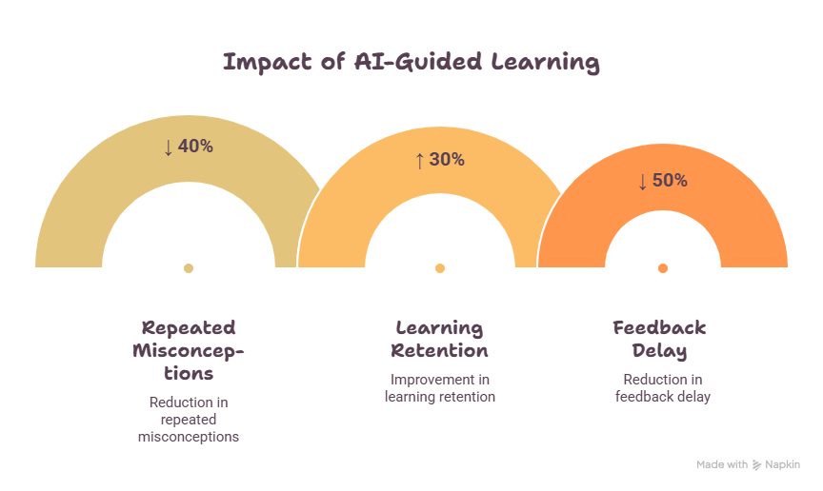
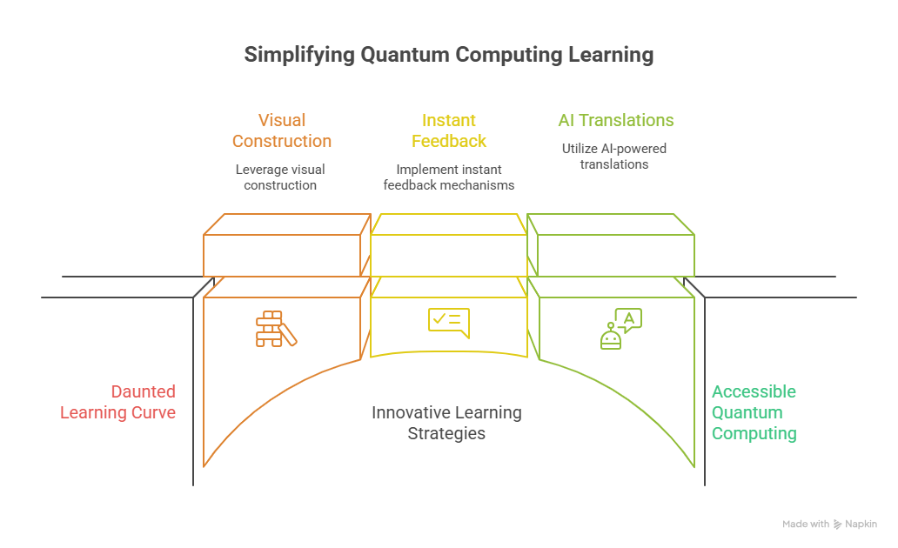
IMPACT AND BENEFITS
Your Team Name
MAKING QUANTUM LEARNING SIMPLE
Visual Learning → Instant Feedback → AI Guidance → Accessible Quantum Education
PROJECTED TARGET IMPACT
↓40%
Repeated Misconceptions
Target reduction through adaptive re-teaching
↑30%
Learning Retention
Target improvement through simulation + guided practice
↓50%
Feedback Delay
Target reduction through instant AI guidance
BENEFITS
1. STUDENTS
Understand: Visual concepts & quantum circuits
Practice: Build and simulate algorithms
Improve: Personalized AI re-teaching
2. EDUCATORS
Detect: Identify learning gaps
Analyze: View misconception patterns
Intervene: Targeted re-teaching insights
3. INSTITUTIONS
Deploy: Web + mobile learning
Reduce Barrier: No quantum hardware for MVP
Scale: More algorithms & languages

Slide 6
RESEARCH AND REFERENCES
Your Team Name
Existing Platforms Reviewed
Qiskit Textbook & Quantum Katas: comprehensive content, but a fixed sequence — no adaptation to a learner’s mistakes (qiskit.org/learn)
NVIDIA CUDA-Q Academic: strong simulation depth, but GPU-dependent — excludes most tier-2/3 Indian colleges
IBM Quantum Learning: large content library, but explanations don’t change based on individual responses
Gap Identified
Cross-checked all platforms above — none re-teach a concept differently after detecting a wrong answer
Adaptive tutoring (knowledge tracing) exists in math/language EdTech, but not yet applied to quantum computing
This is a subject-specific gap, not a claim of inventing adaptive learning itself
Academic Research Reference
2025 arXiv preprints propose AI-personalized quantum curricula — still lab/prototype stage, no deployed product
Findings support feasibility of LLM-based concept explanation for quantum topics
No existing paper combines this with classroom-level mistake analytics (our added layer)
Policy & National Relevance
National Quantum Mission (₹6,003 Cr, Govt. of India, 2023–2031) targets skilled quantum workforce development
Current NQM skilling initiatives rely on static coursework; adaptive tools are not yet part of the ecosystem
Platform directly supports the Mission’s education & skilling pillar
Technical References
Qiskit AerSimulator documentation — circuit simulation & measurement accuracy validation
IBM Quantum docs — used to cross-verify algorithm correctness (Grover’s, Deutsch–Jozsa)
Qiskit textbook content — grounding source for AI explanations, reducing hallucination risk
Tools & APIs Used
Groq API (console.groq.com/docs) — free-tier LLM inference for adaptive tutoring logic
FastAPI — backend framework for tutor and simulator endpoints
React — frontend for lesson delivery and the teacher dashboard

Slide 7
IMPORTANT INSTRUCTIONS
Please ensure below pointers are met while submitting the Idea PPT:
Kindly keep the maximum slides limit up to six (6). ( Including the title slide)
Try to avoid paragraphs and post your idea in points /diagrams / Infographics /pictures
Keep your explanation precise and easy to understand
Idea should be unique and novel.
You can only use provided template for making the PPT without changing the idea details pointers (mentioned in previous slides).
You need to save the file in PDF and upload the same on portal. No PPT, Word Doc or any other format will be supported.
Note - You can delete this slide (Important Pointers) when you upload the details of your idea on SIH portal.

